Slide 1
ASP Presentation
Shafiq Nayli Nicole​

Slide 2


Agenda
A
Introduction
Insights
Summary

Slide 3
Introduction
Analyze and understand the project requirements
Objective – Top 3 countries to Singapore from Europe in 10 years

Slide 4
Insights

Slide 5
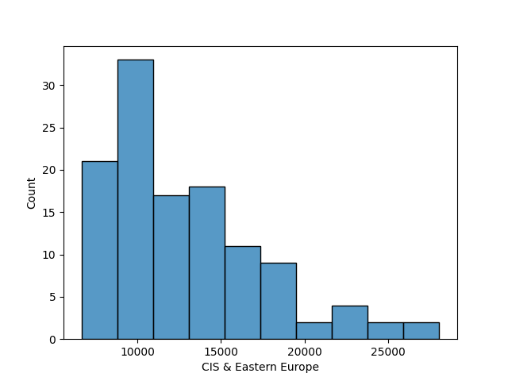
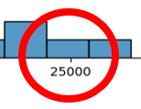
3rd – CIS & Eastern Europe
Recorded 25,432 visitors on Jan 2015
Lowest visitors 6,662 on June 2009
Legend
Highest
Lowest

Slide 6
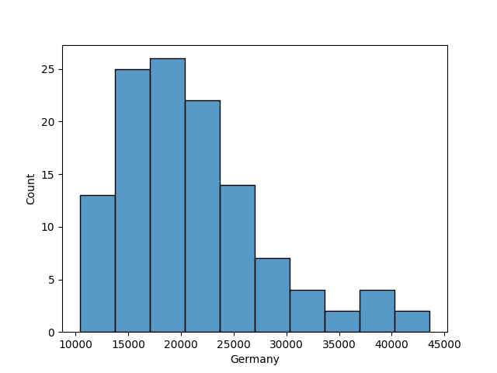
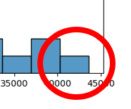
2nd – Germany
Recorded 40,603 visitors on March 2016
Lowest visitors 10,373 on June 2009
Legend
Highest
Lowest

Slide 7
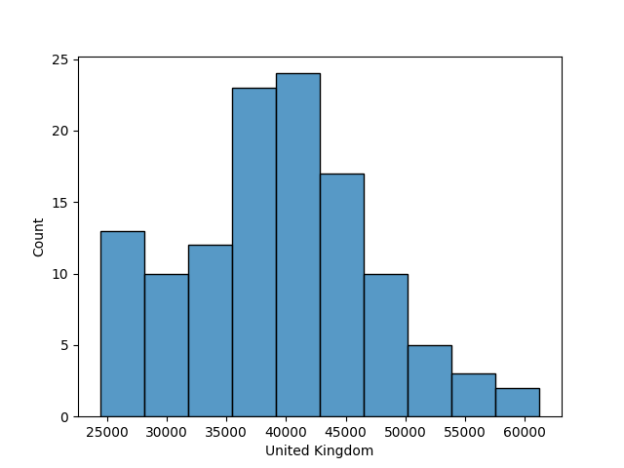
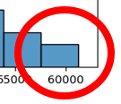
1st – United Kingdom
Recorded 61,263 visitors on March 2008
Lowest visitors 24,462 on June 2011
Legend
Highest
Lowest

Slide 8
Summary
2009, has been an outbreak of Influenza (H1N1). Hence, it shows the decline of visitors in June 2009.
Drop of 36,801 visitors from UK due to the global economic prices of 2008-2009 international tourist arrivals decline by 4% & international tourism receipts by 8%.
Tourism is one of the industries in Singapore. We could expect the visitors to double in upcoming future.

Slide 9
Thank you

